Slide 1

Occupations
CUDAP Sign Choir, 4/11/18

Slide 2
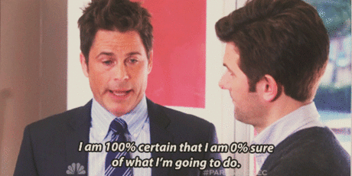
Word List
Work
Job
Boss
Employee
Doctor
Lawyer
Engineer
Programmer
Police Officer
Firefighter
Actor
Scientist
Chef
Businessman
Salesman
Politician
Astronaut
Athlete

Slide 3
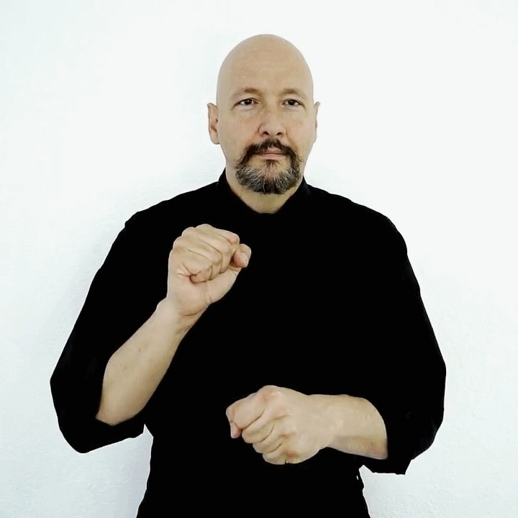
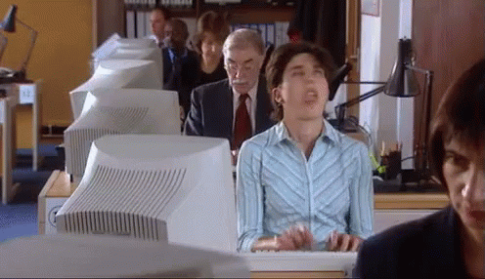
Work
Description: Make 2 fists, tap right wrist to side of left hand

Slide 4
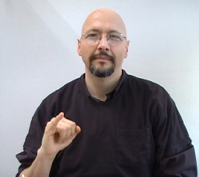
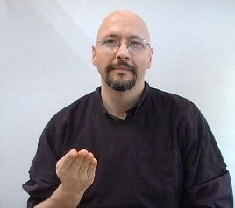
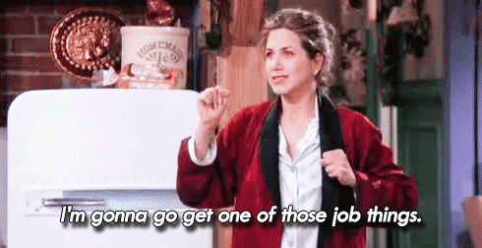
Job
Description: Letter “J” and then a “B” with palm up

Slide 5
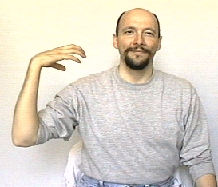
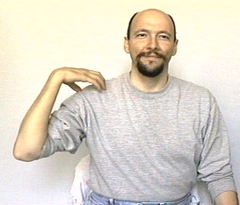
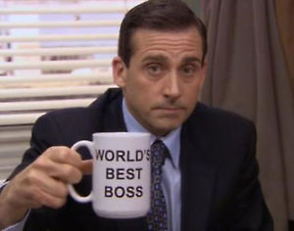
Boss
Description: Tap your right hand on your right shoulder twice

Slide 6
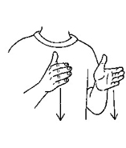
Employee
Description: Work + agent- bring both flat hands straight down

Slide 7
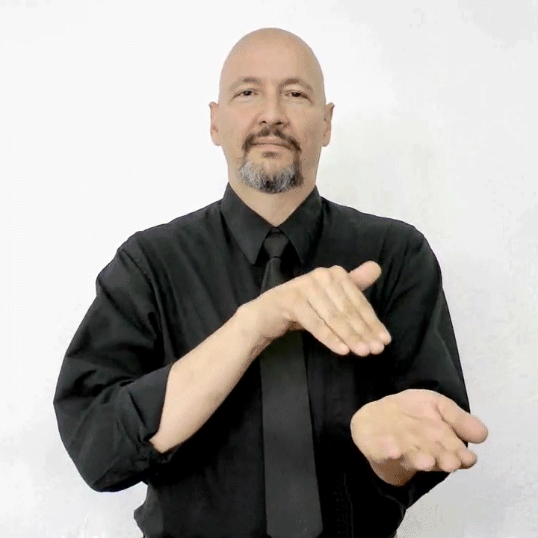

Doctor
Description: tap fingers of your bent right hand twice on the inside of your left wrist (like taking a pulse)

Slide 8
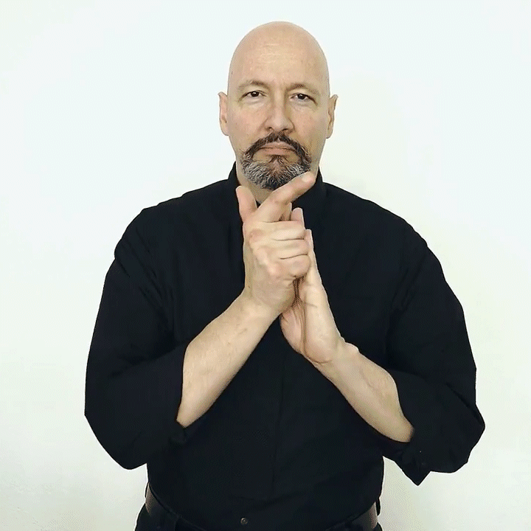
Lawyer
Description: Law + agent- tap an L-hand to top of left palm and then bottom

Slide 9
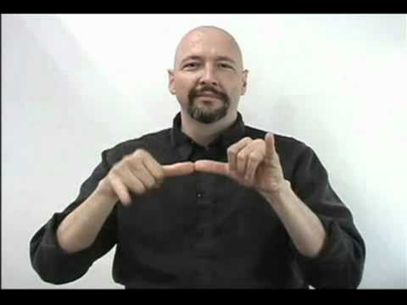

Engineer
Description: Measure+agent- touch both thumbs together, twist right hand down and up, then left hand

Slide 10
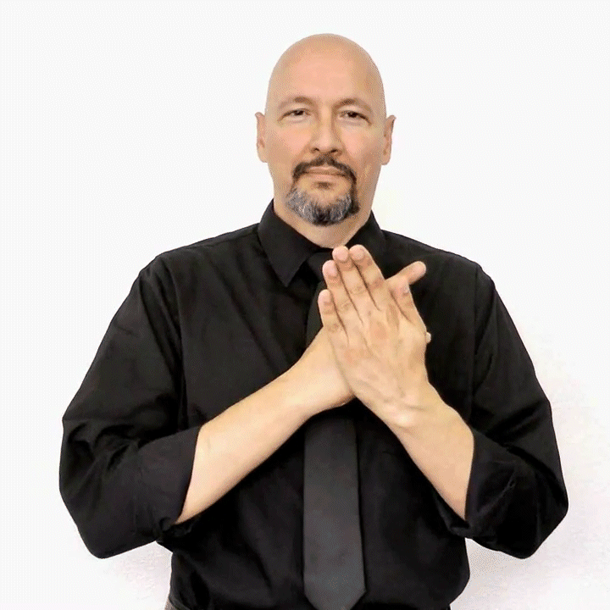

Programmer
Description: Program+agent- slide P-hand down left palm, then back of left hand

Slide 11
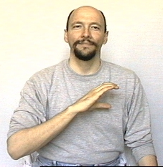
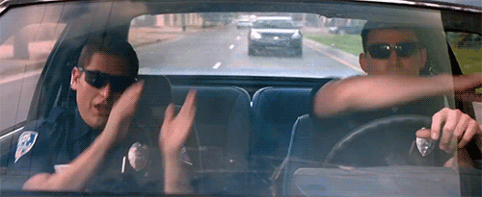
Police Officer
Description: Tap a C-hand on your chest twice

Slide 12
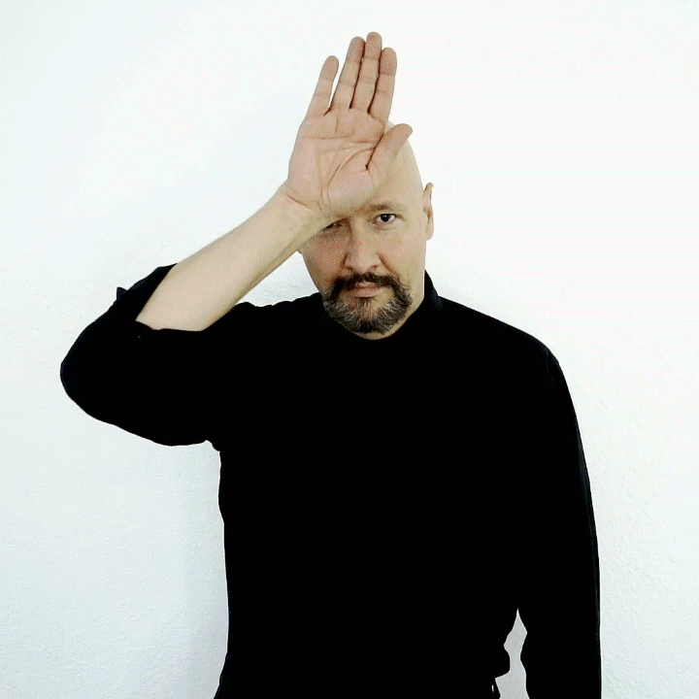
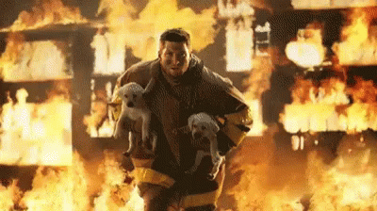
Firefighter
Description: Tap back of right hand to forehead twice

Slide 13
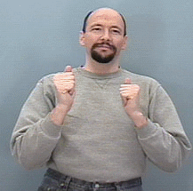

Actor
Description: Act+agent- circle 2 A-hands towards yourself, thumbs pointing at you

Slide 14
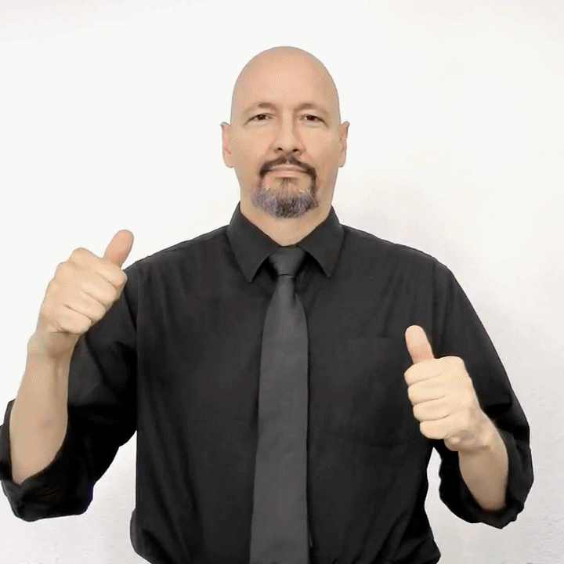

Scientist
Description: Science+agent- make circles with two open-A hands (like pouring chemicals)

Slide 15
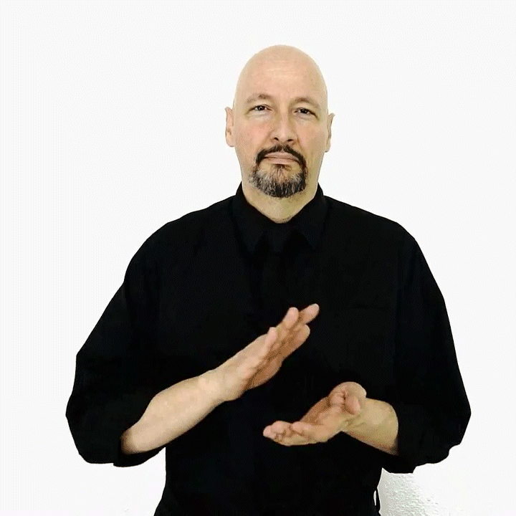
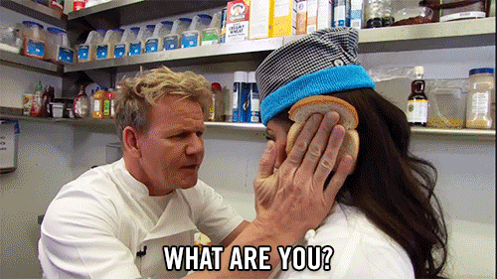
Chef
Description: Cook+agent- right hand palm down on left, then flip to palm up (like grilling something)

Slide 16
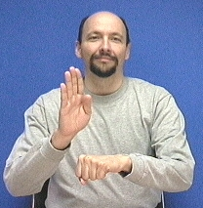
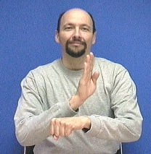
Businessman
Description: Business+agent- move a B-hand along your left arm (left to right)

Slide 17
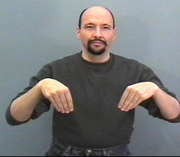
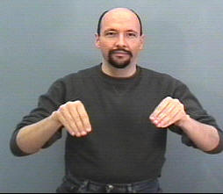
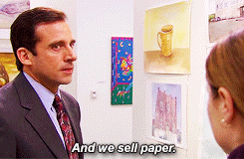
Salesman
Description: Sell+agent- bend both hands forward once

Slide 18
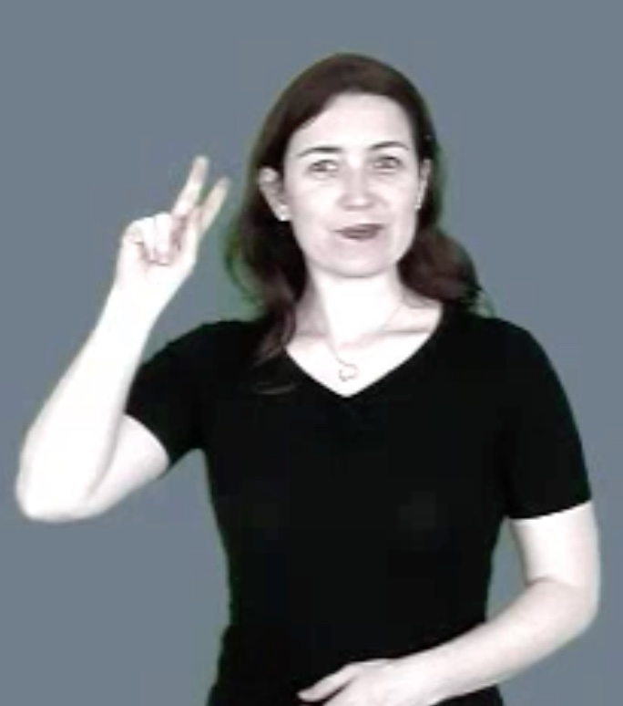
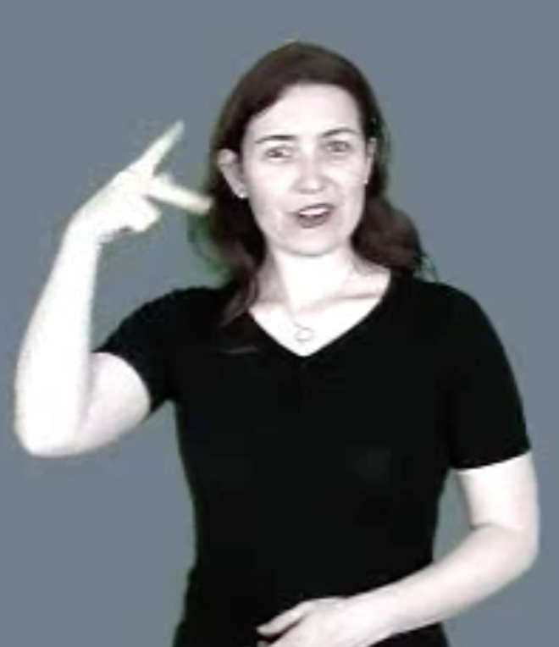
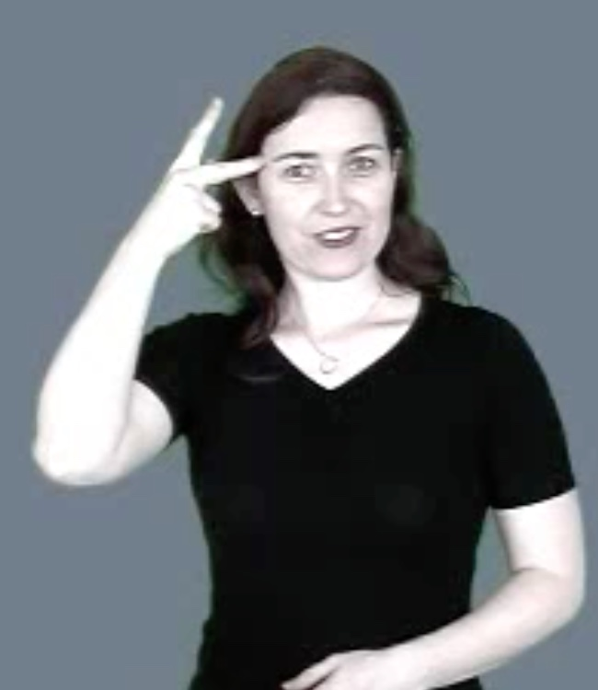
Politician
Description: Politics+agent- make a circle near your temple with a P-hand

Slide 19
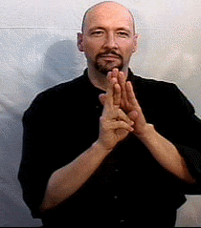

Astronaut
Description: Rocket+agent- move right R-hand up palm of left hand (like a rocket blasting off)

Slide 20
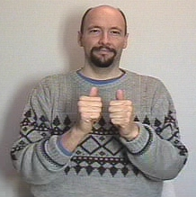
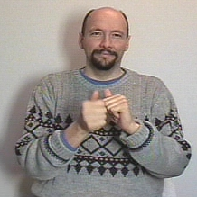
Athlete
Description: Sports+agent- alternate twisting once A-hand forward (like each hand is trying to catch up to the other)

Slide 21
Questions?

